Slide 1
IT4010 – Progress Presentation 2 (PP2)
Group: 25-26J-076
ForLens – A Lightweight AI-Driven Endpoint Security Solution for Real-Time Threat Detection in SMEs]

Slide 2
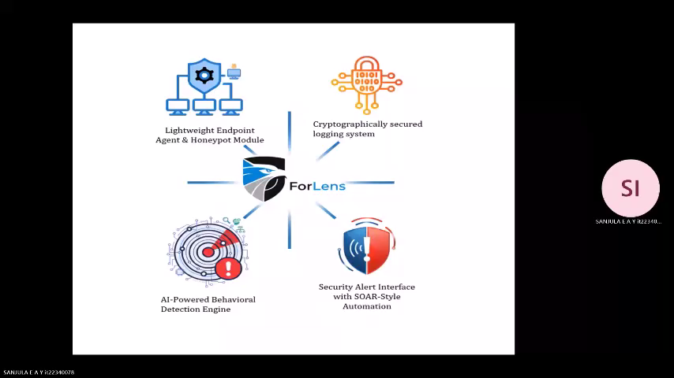


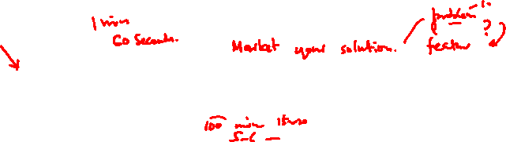
Agenda (5 min overview + 30 min demo)
Add One Minute Video of Your Solution
1) Problem & motivation (30–45 sec)
2) Proposed solution overview (architecture) (45–60 sec)
3) System Architecture & Integration(60–90 sec)
4) Commercialization(60–90 sec)
5) Demo Plan + roles (30–45 sec)
Notes:
Keep the overview within 5 minutes. Use this slide as your time anchor.

Slide 3
Problem Statement & Stakeholders
Context: Cyber Security solution built for Small Medium Enterprises (SME)
Stakeholders: Managers, business owners, small IT teams
Observed issue: SME’s have limited budgets, expertise and require resources to procure and use enterprise grade endpoint protection solutions.
Why it matters: Saves cost, reduces errors, efficient & business friendly.
Notes:
State the problem precisely and measurably. Avoid long background. One slide only.

Slide 4
Research Gap & Objectives
Gap: SMEs lack a lightweight, affordable, and explainable SOAR-style security solution that can operate with minimal expertise in noisy, low-resource environments.
Main objective: Develop an integrated, AI‑enhanced endpoint security system with honeypot, tamper‑evident logging, and automated response capabilities to improve threat detection and response efficiency.
Notes:
Restate objectives exactly as in proposal unless formally revised. PP2 evaluates alignment.

Slide 5
Solution Overview (What You Built)
Solution summary: An light weight endpoint protection solution built for SMEs
Key features delivered:
[FR1]Log collection and monitoring
[FR2] The system uses machine learning and threat intelligence to analyze real-time endpoint telemetry and behavioral logs, detect anomalous user activity, and generate high-confidence alerts for potential insider threats.
[FR3] Generates non technical user insights.
Non-functional focus: Speed, ease of use, protection against unauthorized access.
Current completion status: ~90%
Notes:
This is the product view: what exists now as an integrated solution.

Slide 6
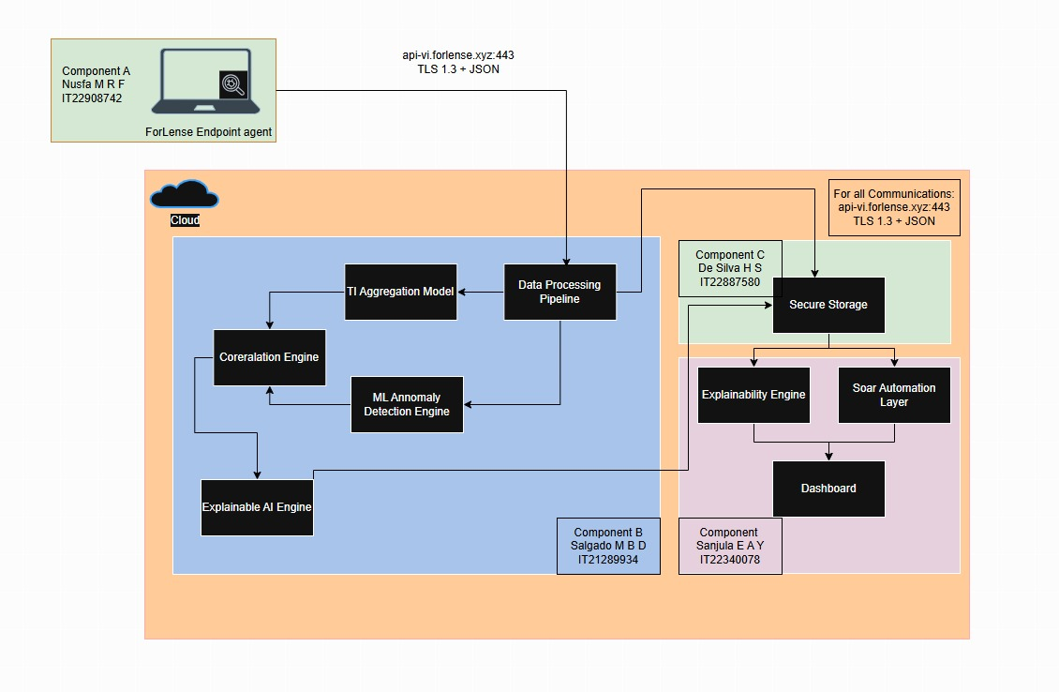
System Architecture & Integration
Notes:
Show one clear diagram. Explain data flow end-to-end. Mention interfaces and consistency.

Slide 7


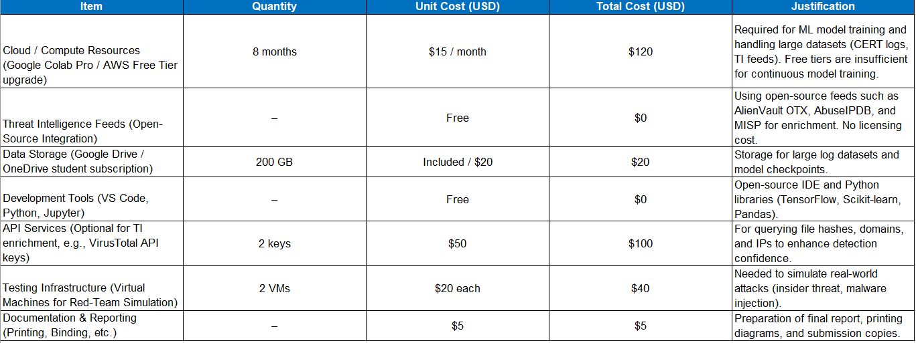
Commercialization
Market Gap: SMEs face Cyber threats but can’t afford enterprise tools (e.g., Splunk, Varonis) and lack technical expertise.
Value Proposition: Lightweight, AI-driven detection + honeypot traps + tamper-proof logging + SOAR-like automation, all SME-friendly.
Target Market: SMEs; Managed Service Providers (MSPs).
Business Model: SaaS subscription (per endpoint/month)
Advantages: Affordable, scalable, compliance support, unique vs. open-source tools.
Challenges: Competing with free tools, reducing false positives, scaling support.
Roadmap: Prototype → MVP pilot with SMEs → SaaS subscription → MSP partnerships → Expansion.
Source: World Bank
Real World Usage
Simple and Proactive Security: Unified dashboard, self learning.
Fast and Automated Response: Immediate actions, automated workflows, One click control
Advanced benefits: Custom playbooks, Automated & business reporting
Total Investment for prototype with buffer: $485
9/8/2025
28

Slide 8
DEMO

Slide 9
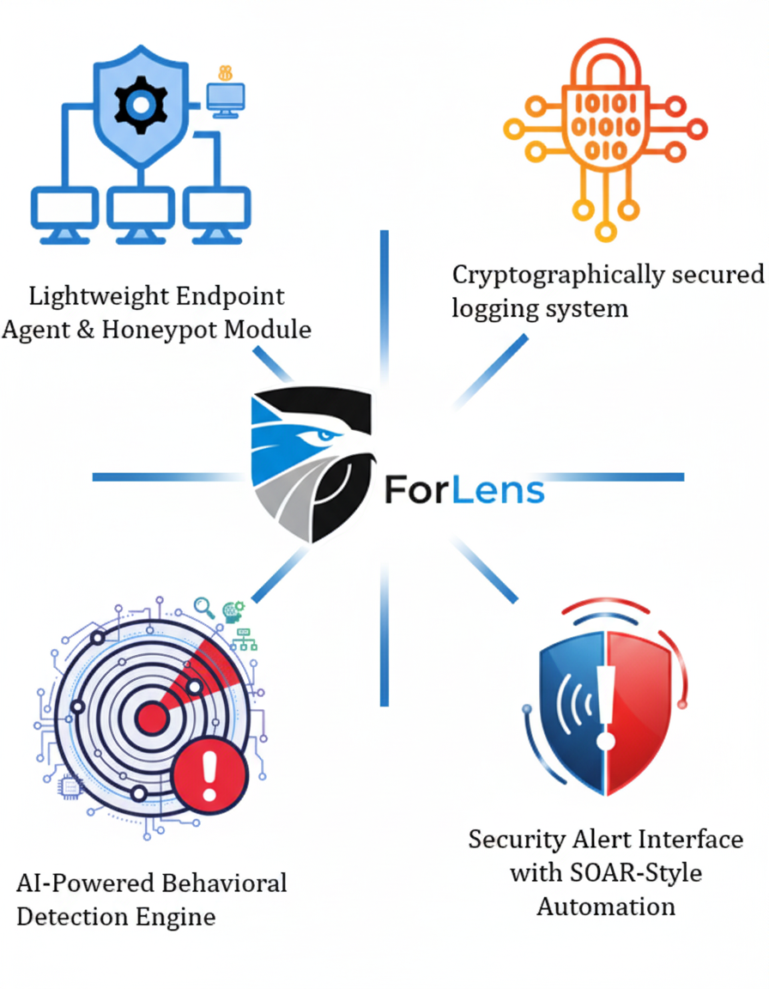

Slide 10
Commercialization / Impact (Short)
Target users/market: [who benefits]
Value proposition: [why better than alternatives]
Cost and feasibility: [rough estimate]
Adoption plan / next steps: [pilot, rollout]
Notes:
Keep this concise, but concrete. Link impact to measured results where possible.

Slide 11

Demo Plan (30 min) – What We Will Show
Demo flow (end-to-end): [Step 1 → Step 2 → Step 3]
Where each member takes over: [Name → part]
Backup plan: recorded demo/screenshots + test data ready
What to watch for: key features + metrics
Notes:
A demo roadmap keeps the session controlled. Avoid wasting time navigating menus or setup.

